Slide 1

Do we know our supplier?
Through XKCD cartoons

Slide 2



Slide 3

Understanding the data

Slide 4
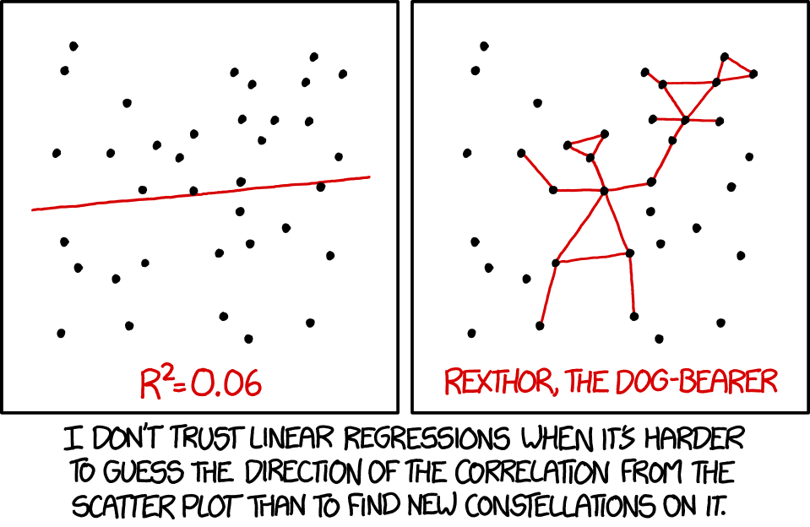
Understanding how policy changes procurement

Slide 5
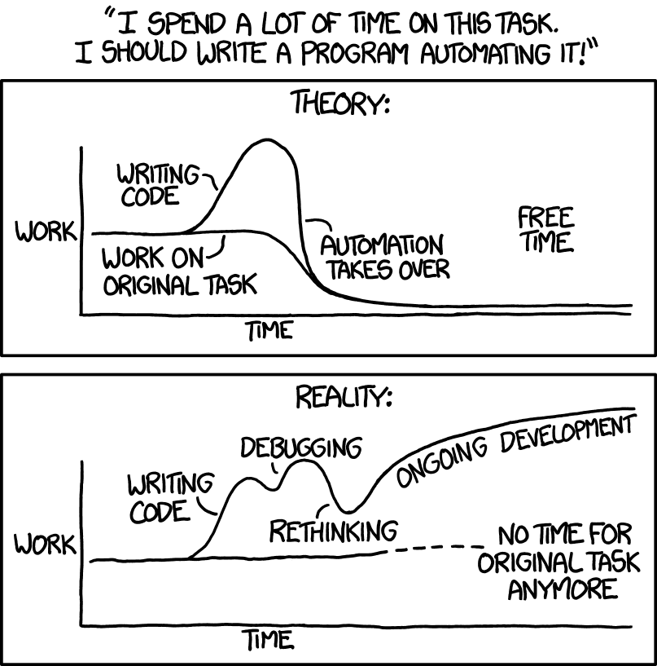
Visualisation in Cloud.gov.au

Slide 6
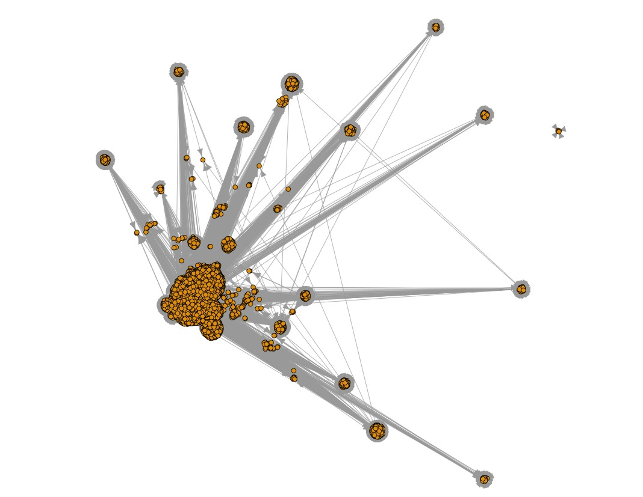
So Far
Supplier | Number of contracts
thales australia limited | 12699
australian government solicitor | 10865
hays specialist recruitment (australia pty limited | 10837
bae systems australia limited | 6505
spotless facility services pty ltd | 5636
telstra corporation limited | 5025
leaseplan australia limited | 4566
dell australia pty limited | 4386
sikorsky aircraft australia ltd | 4286
hewlett-packard australia pty ltd | 4148
paxus australia pty limited | 4113
k p m g | 4052

